Slide 1
Introduction to data science
Course: Introduction to data science
Lecturers: Yonatan Schler, Naama…
Names: Oz wiess, Vlad Sadovnikov
ID: 220…556, 321744096

Slide 2
Intro to research:
Research question:
* can we predict how much views, likes or comments video on
youtube can get?
* which properties the videos have that makes them more
popular?

Slide 3
Data sources
Data set from Kaggle:
Trending YouTube Video Statistics

Slide 4
Data cleaning
Find how much ‘nun’ we have, check all the data set
has the same formats
Outliners handling

Slide 5
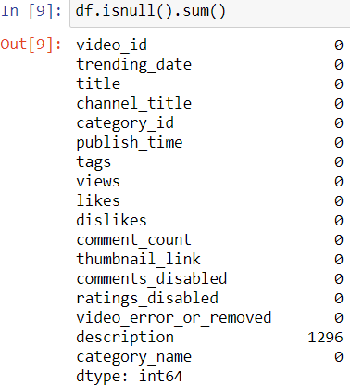
Missing data

Slide 6
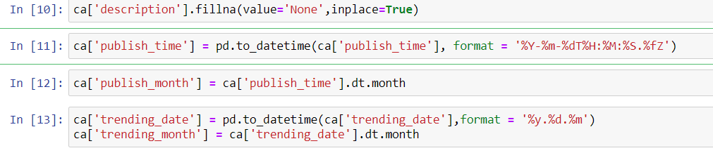
Formats of date and time

Slide 7
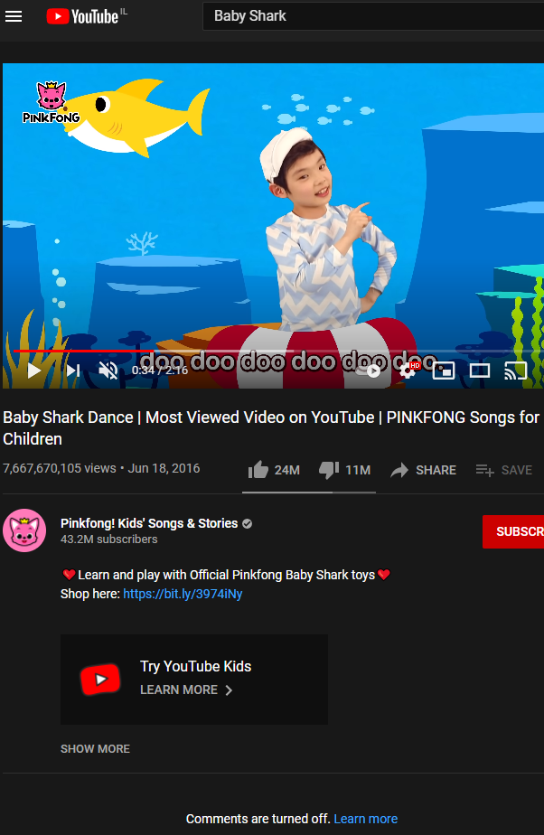
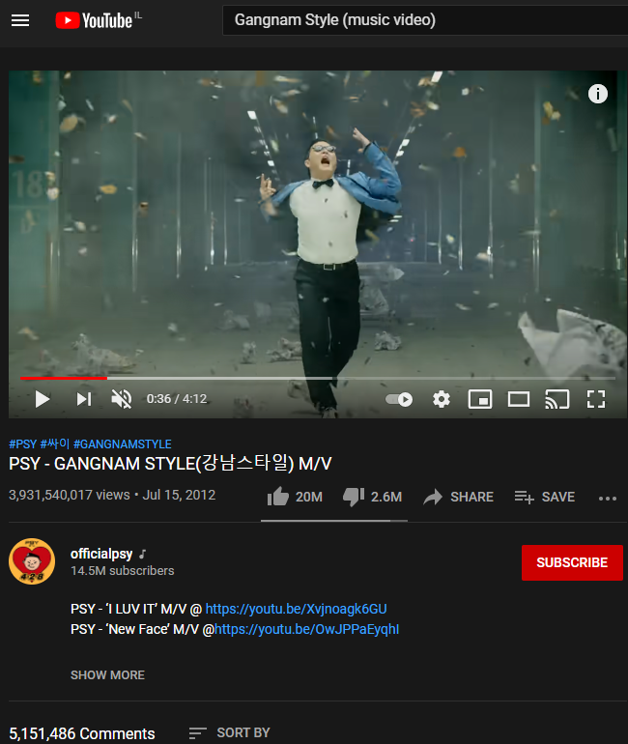
EDA
Gangnam Style:
First video over 1B views.
Baby Shark:
Most viewed video today on YouTube.

Slide 8
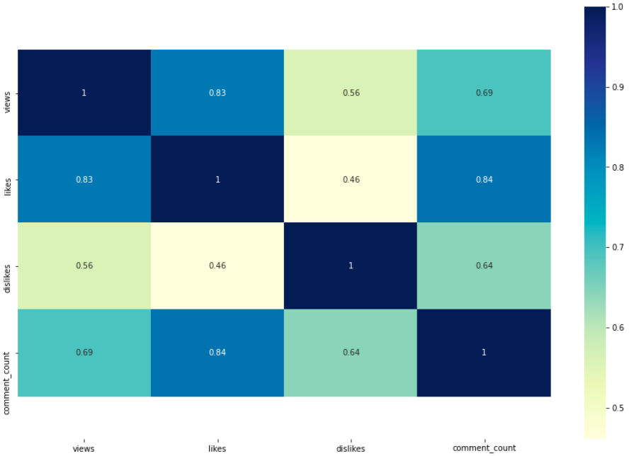
Most correlated parameters
Hight correlation:
+0.8
(likes:views) (likes:comment_count)
Medium correlation:
+0.6 (views:comment_count)

Slide 9
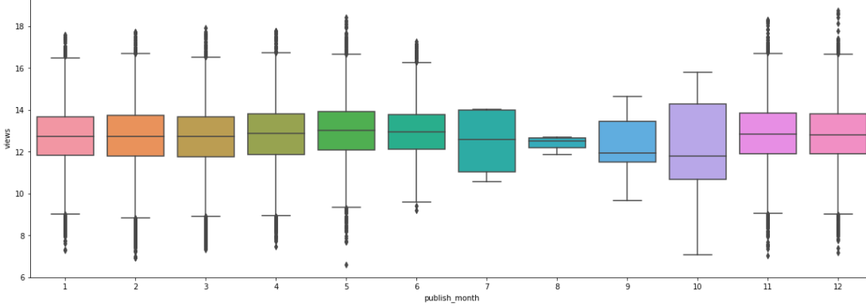
Amount of views by Month
Name: Boxplot that compares amount of views and month video published.
X-axis: publish month
Y-axis: views
Conclusion: there are more views on videos that published on August and
October.
**compare between publish month and likes shows same results.

Slide 10
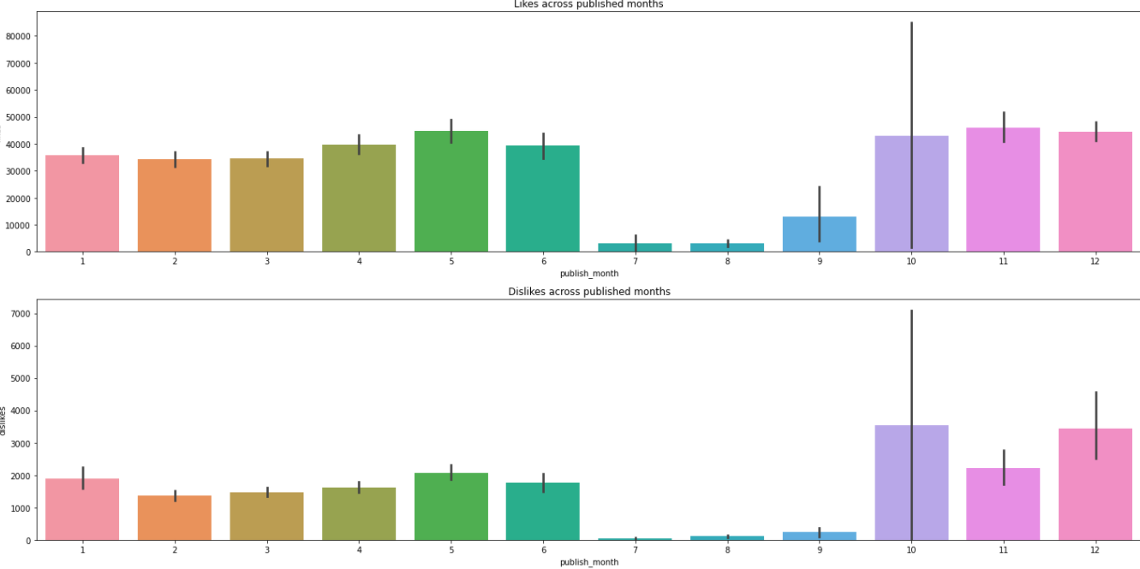
Amount of likes/dislikes by month
Name: Barplot that compares amount of likes/dislikes and month video published.
X-axis: publish month
Y-axis: likes/dislikes
Conclusion: easy to see that July, august and September have less activity in this compare.

Slide 11
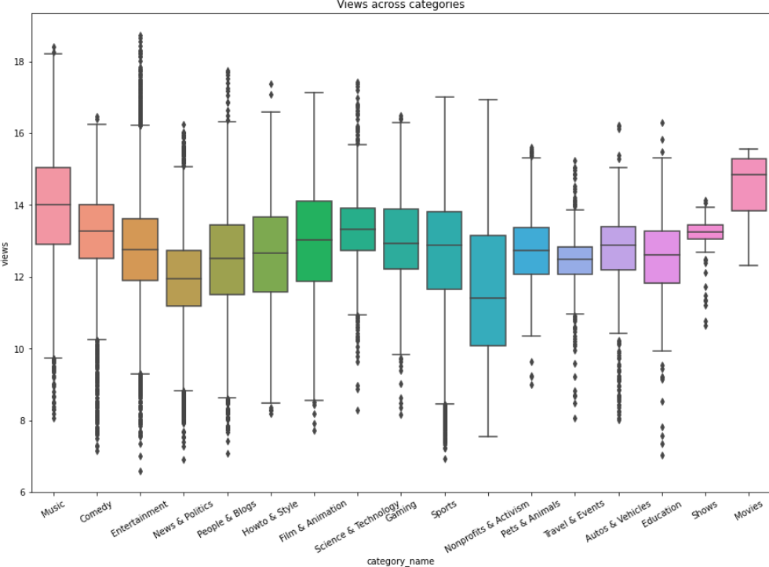
Amount of views per category
Name: Boxplot that compares amount of views and category of video.
X-axis: category
Y-axis: views
Conclusion: music and movies are most viewed videos on YouTube.

Slide 12
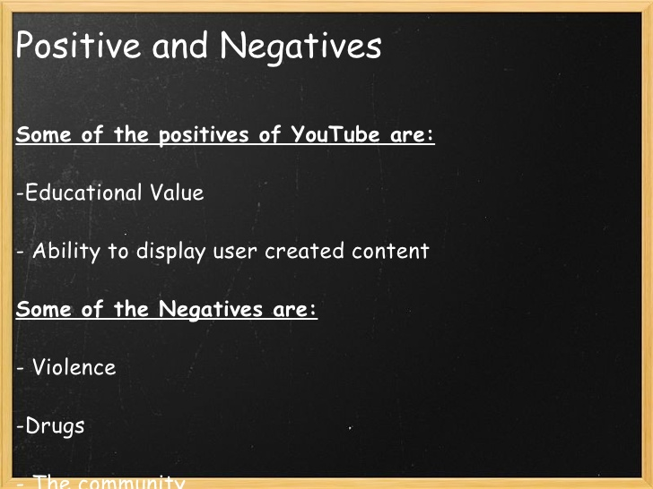

Slide 13
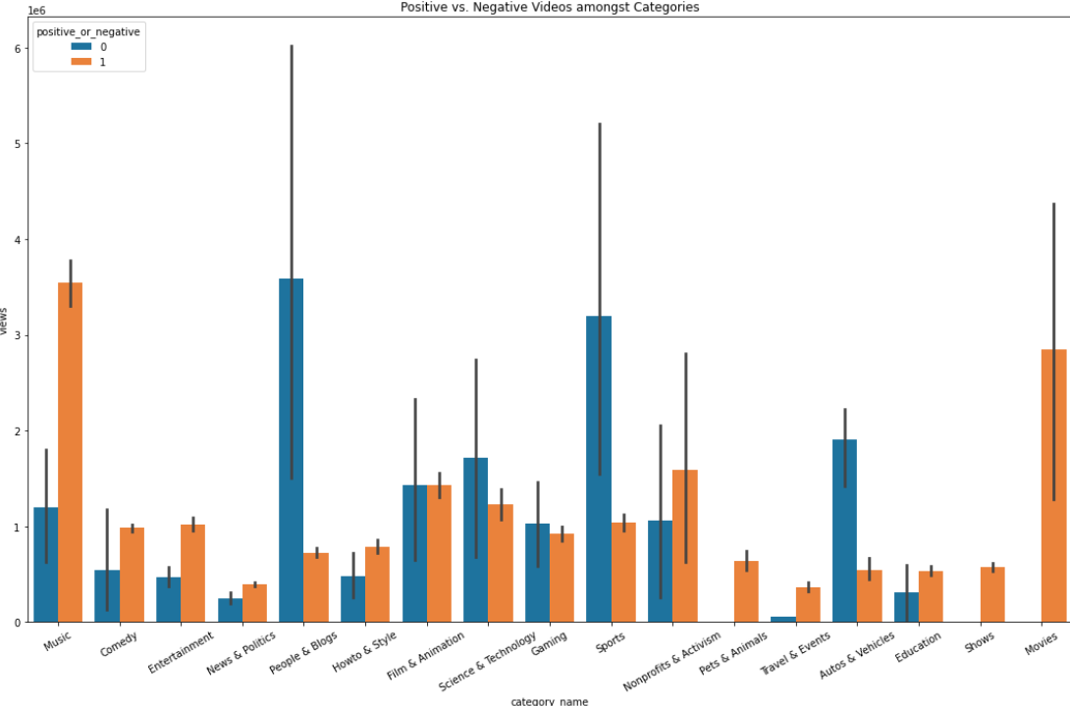
Positive or negative?
Name: Barplot that compares positive and negative amongst categories.
X-axis: category
Y-axis: views
Conclusion: music and movie are the most popular videos although the have a lot of negative issues.

Slide 14
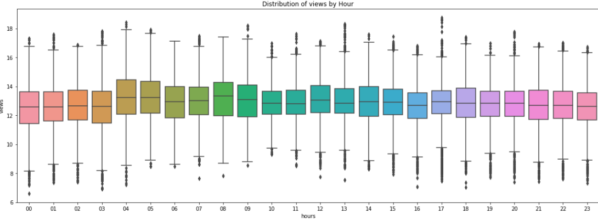
Time against popularity of video
Name: Boxplot that compares amount of views and hour video published.
X-axis: publish hour
Y-axis: views
Conclusion: not matter the hour of publishing the video.
**compare between publish month and likes shows same results.

Slide 15
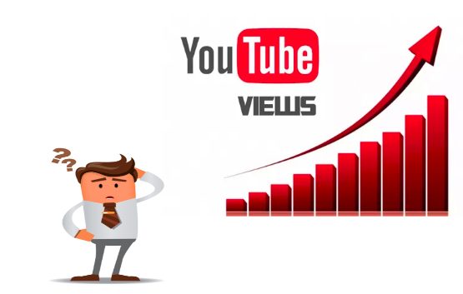
Machine Learning

Slide 16
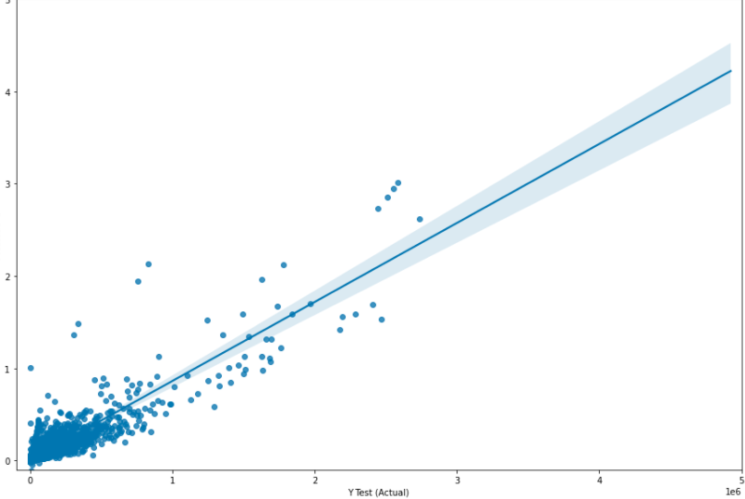
Linear regression
Using ‘sklearn’ library and liner regression we were able to train a model that predict the popularity/success of new uploaded video on YouTube.
The model predicted that if we will based on likes, views and comments our r^2 will be 0.839..

